Slide 1




What is AI?
Artificial Intelligence refers to the development of computer systems that can perform tasks typically required by humans, such as learning, problem-solving, decision-making, and perception.
page 01
AI_ML_007 (Aryan)

Slide 2
The concept of AI dates back to the 1950s, when the first AI program, called the Logical Theorist, was developed by Allen Newell and Herbert Simon.
History of AI
page 02
AI_ML_007 (Aryan)

Slide 3
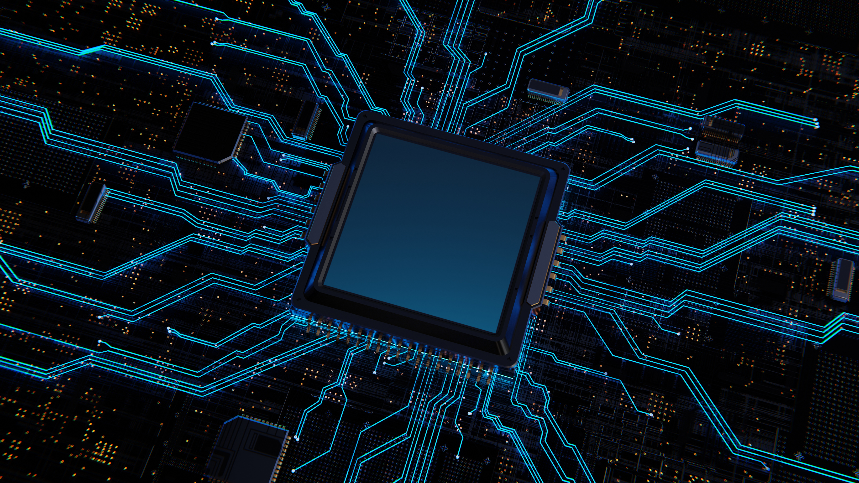
Types of AI
Today, AI is no longer confined to expert systems or narrow applications. We're witnessing a revolution in AI, driven by advances in machine learning (ML) and deep learning (DL).
page 03
AI_ML_007 (Aryan)

Slide 4

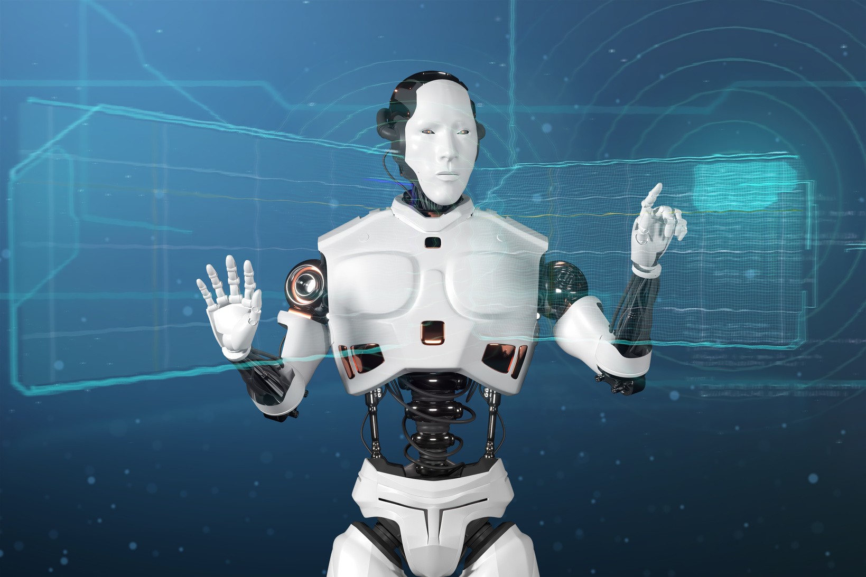
Applications of AI
Virtual Assistants Image Recognition
page 04
AI_ML_007 (Aryan)

Slide 5
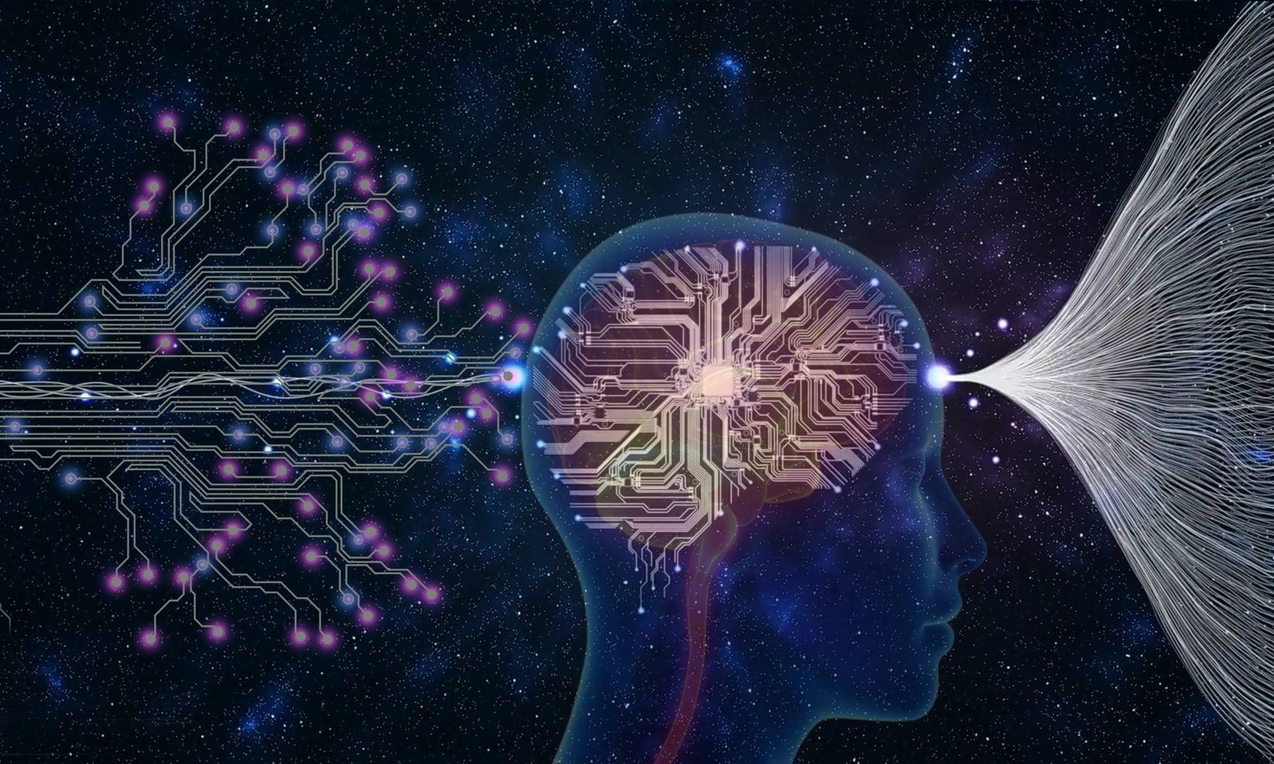
Benefits of AI
Predictive Maintenance Healthcare
page 05
AI_ML_007 (Aryan)

Slide 6
Concerns about AI
Job Displacement Bias and Fairness
page 06
AI_ML_007 (Aryan)

Slide 7
Addressing Concerns
Education and Training Fairness and Transparency
page 07
AI_ML_007 (Aryan)

Slide 8
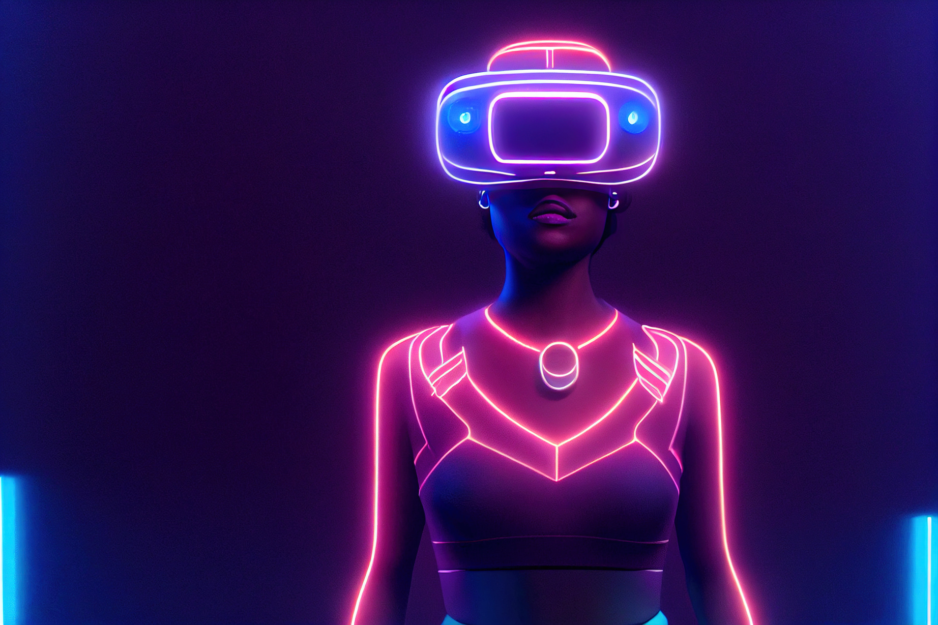
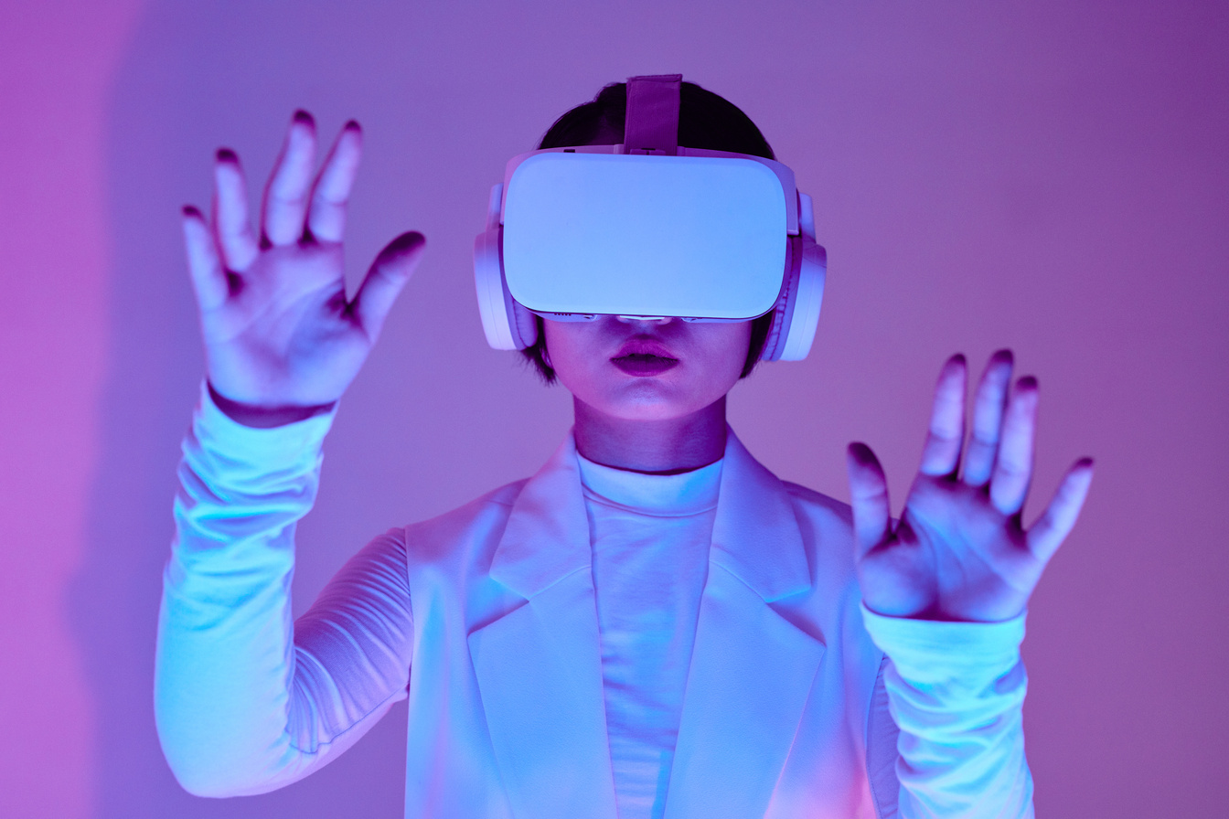
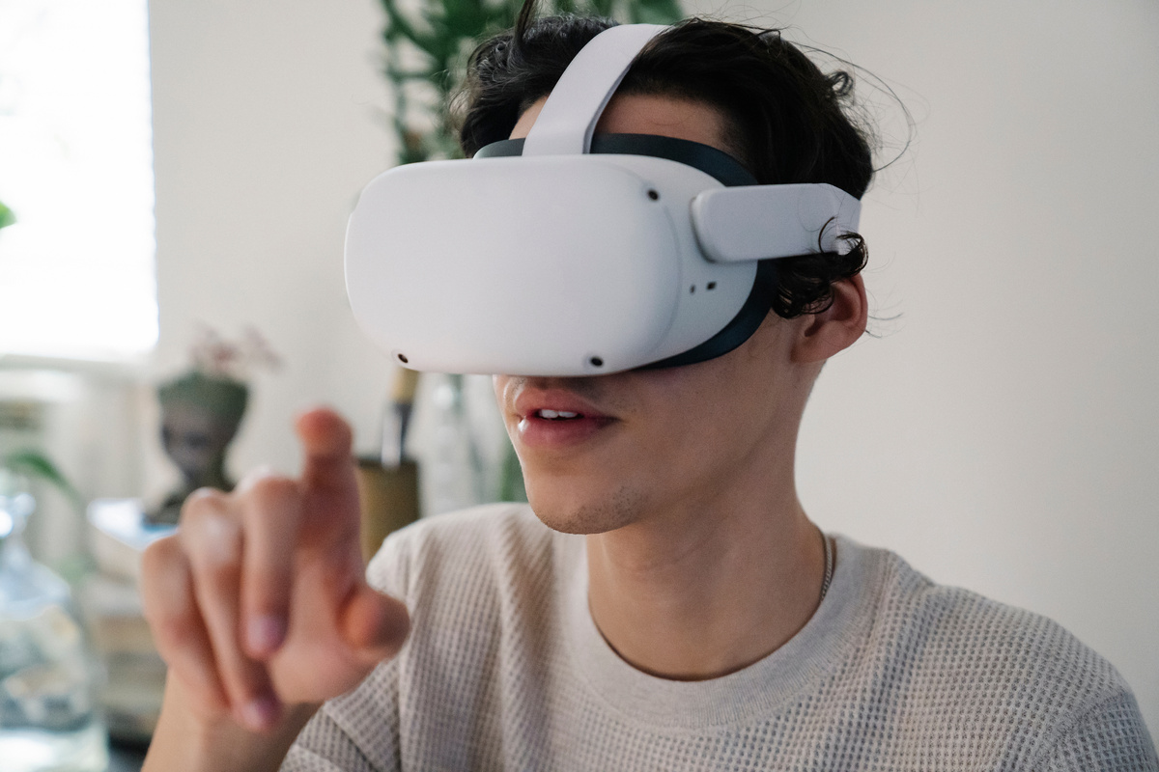
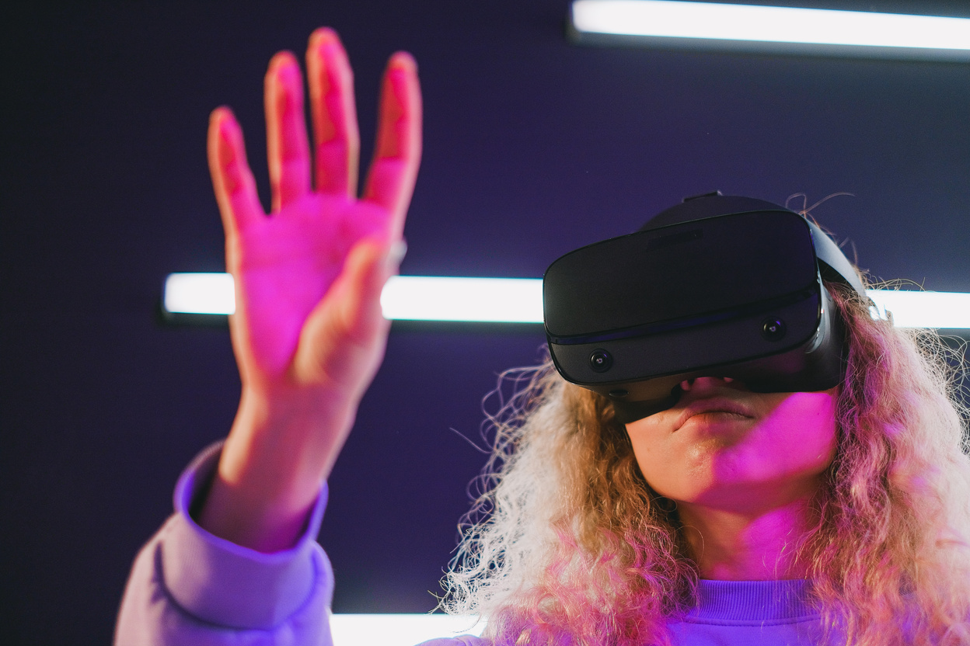
Responsible Development
Encouraging developers to prioritize human values and ethics in their work will help create a more responsible AI ecosystem.
page 08
AI_ML_007 (Aryan)

Slide 9


Conclusion
As we continue on this journey into the world of AI, it's crucial that you understand not only its capabilities but also its limitations and potential risks.
page 09
AI_ML_007 (Aryan)

Slide 10
THANK YOU!
page 10
AI_ML_007 (Aryan)

